Slide 1
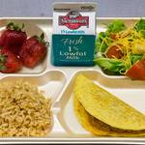
School Lunch made easy Vicki Lewis, Mariana Valles Meza, Mackenzie Richards and Daniel Zamora

Slide 2
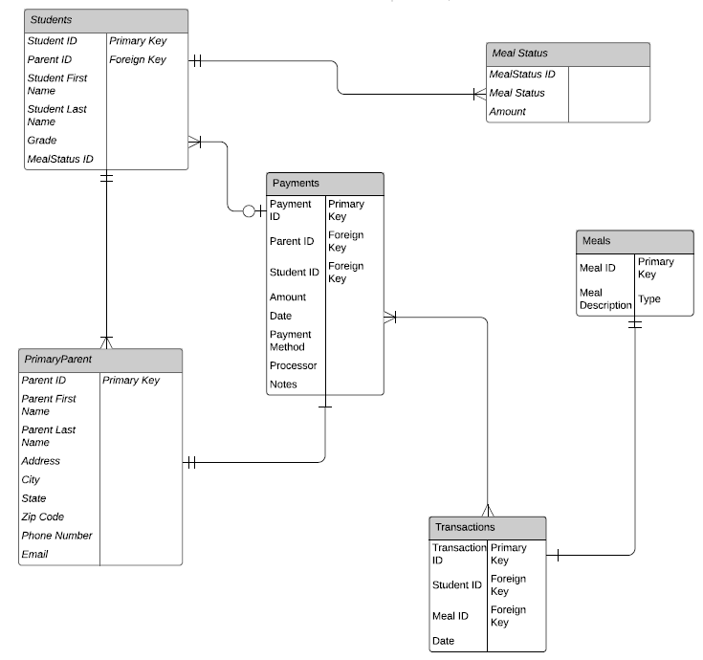
Visual Representation
This is a visual image of how all the information was divided up to be able to store each student’s information and provide you with the information you need at a moments notice.

Slide 3
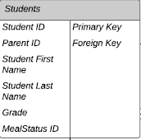
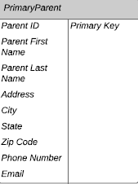
The Database
The database takes the school data, along with the student's meal information gathered from the cafeteria and structures it into separate sets of data.
Each section is titled with the information that is housed within it
Each student is recognized by their student ID and has 1 primary parent.

Slide 4
Your daily reports
We have made the reports that you use on a daily basis and added them in an easy to use report.
First Report
Student List

Slide 5
Students and meal status

Slide 6
Daily transactions
All lunches are full lunches and each meal purchased by a student is a separate transaction.

Slide 7
Total free meals

Slide 8
Total reduced meals

Slide 9
Payment by student

Slide 10
Student balances

